Slide 1
functions
funcs, func expressions, closure, returning funcs, recursion, the stack

Slide 2
functions
functions in go are types
functions behave as types in go
use like any other type
declare them as variables
pass functions around just as you'd pass types around
pass functions just like any other argument / parameter
pass them into functions as arguments
return them from functions
declare functions inside other functions
similar to JavaScript

Slide 3
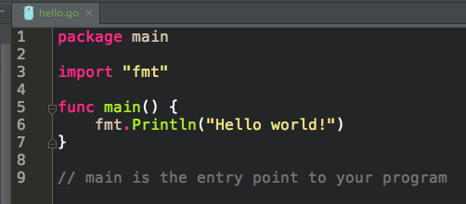
func main
the entry point for your program

Slide 4
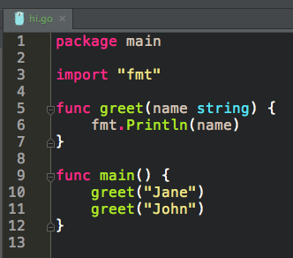
parameter
argument
parameters & arguments

Slide 5
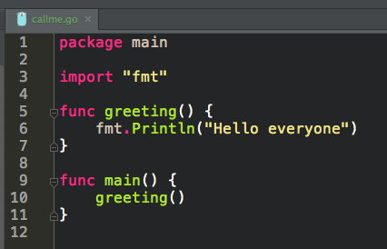
You need the ()
calling a function

Slide 6
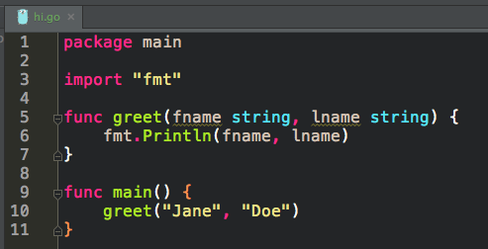
parameters
two params

Slide 7
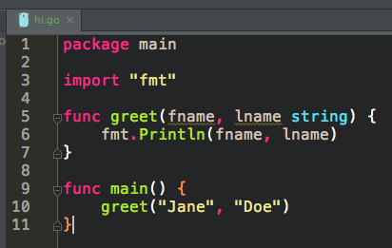
parameters
two params

Slide 8
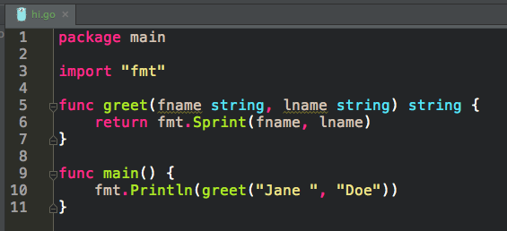
return

Slide 9
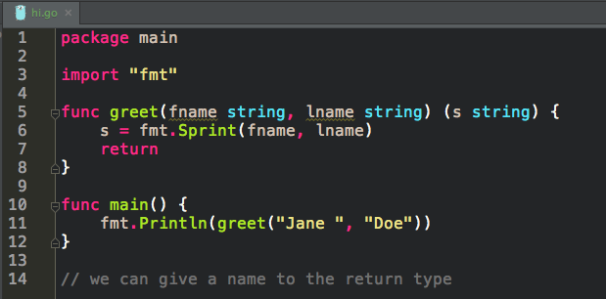
named return

Slide 10
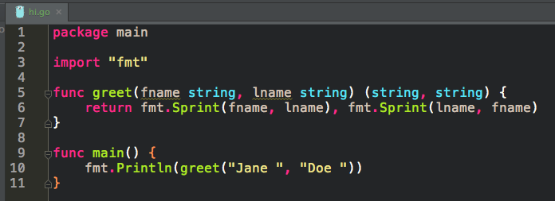
returns
return multiple

Slide 11
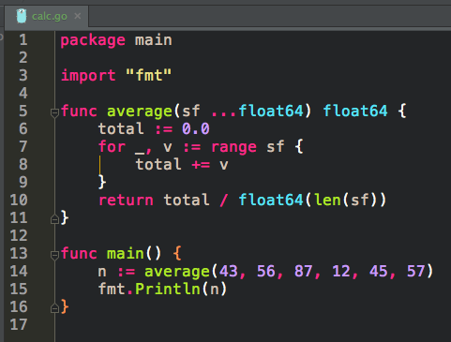
variadic parameters

Slide 12
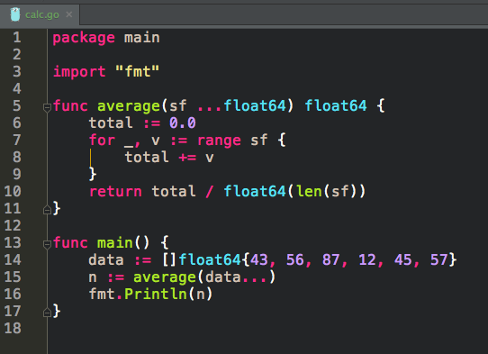
variadic arguments

Slide 13
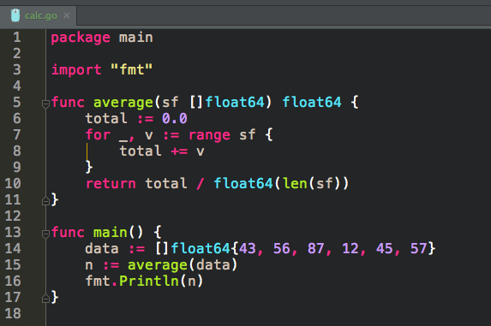
parameter name does not have to match argument name

Slide 14
exercise
Write a function which takes an integer and returns two values:
the integer divided by 2
whether or not the integer is even (true, false)
For example
half(1) should return (0, false)
half(2) should return (1, true).
credit: http://www.golang-book.com/books/intro/7

Slide 15
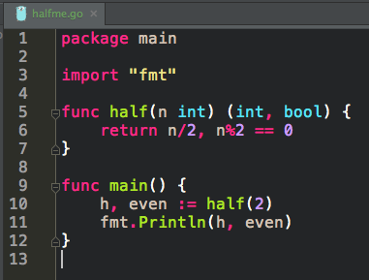
solution to exercise

Slide 16
exercise
Write a function with one variadic parameter that finds the greatest number in a list of numbers.
credit: http://www.golang-book.com/books/intro/7

Slide 17
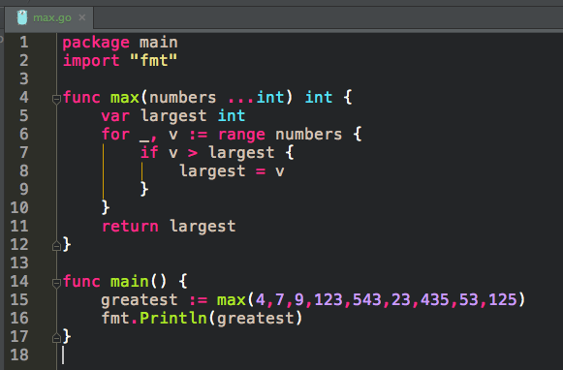
solution to exercise

Slide 18
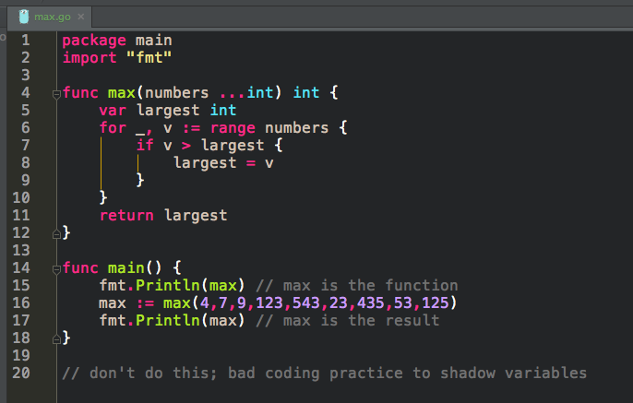
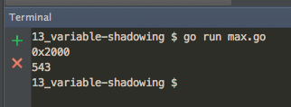
bad coding practice
variable shadowing

Slide 19
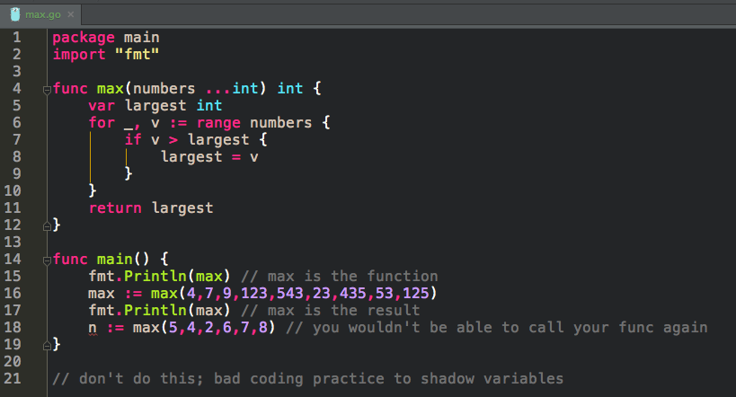
bad coding practice
variable shadowing

Slide 20
func expression
setting a variable equal to a function

Slide 21
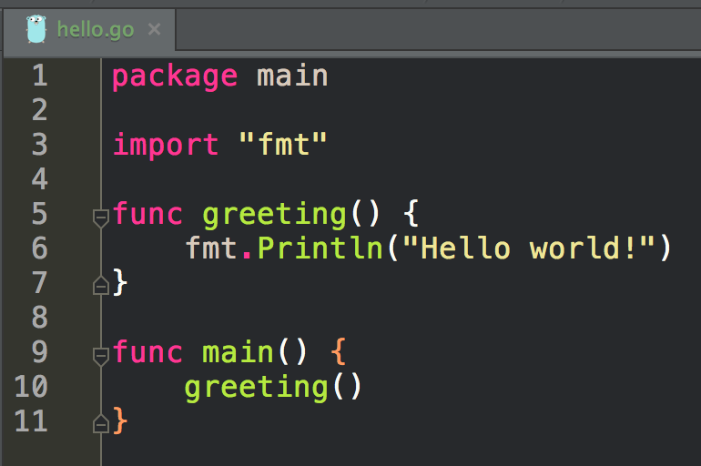
this is not a func expression
this is our code before using a func expression

Slide 22
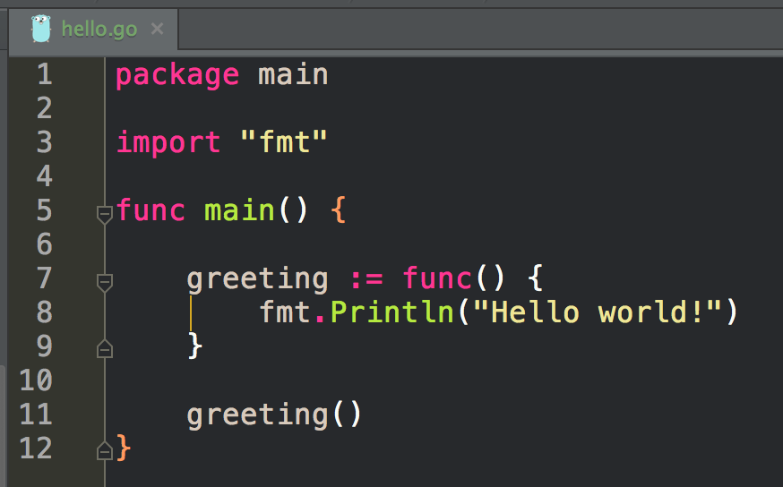
this is not a func expression
this is a func expression
func expression
setting a variable equal to a func
the scope of greeting is func main()

Slide 23
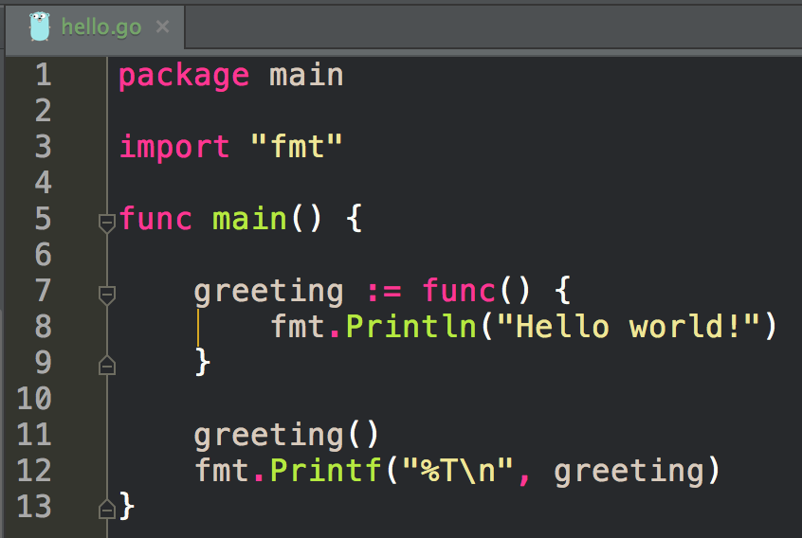
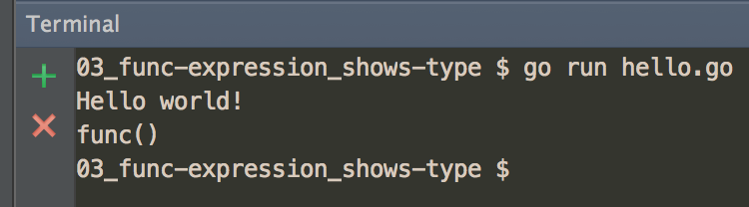
interesting to look at greeting’s type

Slide 24
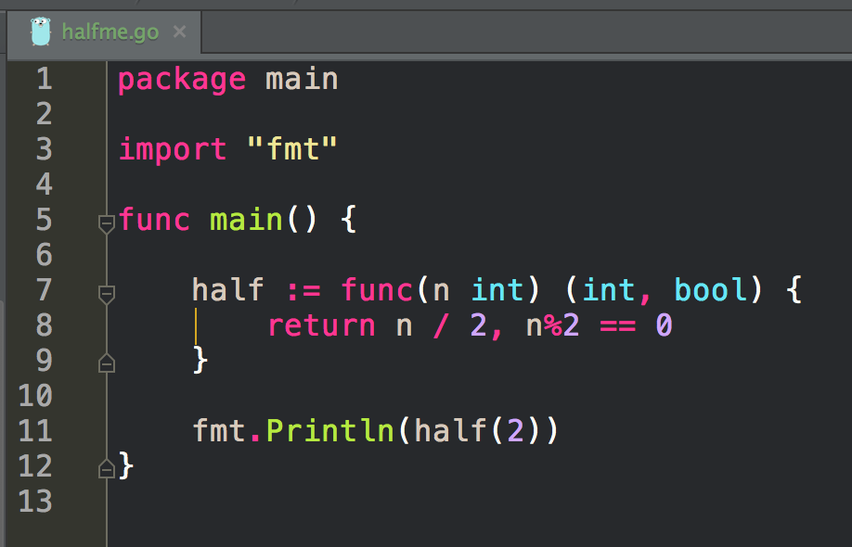
another func expression
setting a variable equal to a func

Slide 25
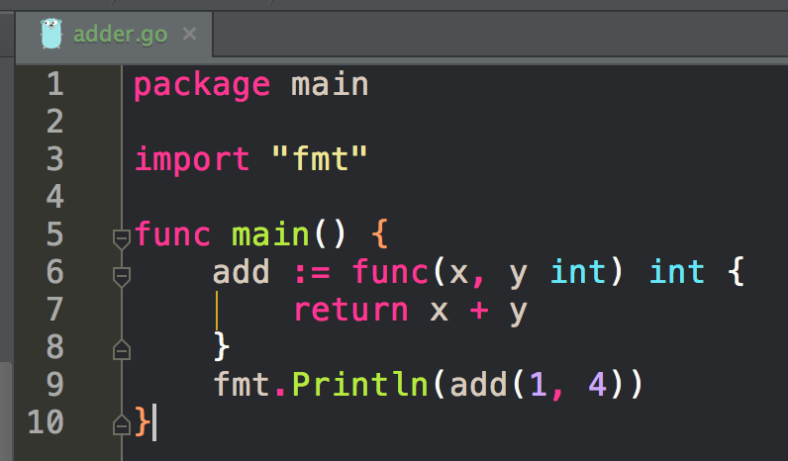
another func expression
setting a variable equal to a func

Slide 26
closure
my definition: “one thing enclosing another thing”

Slide 27
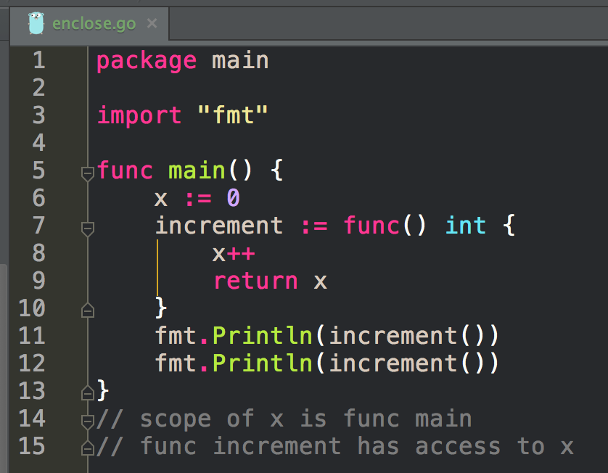
closure
func main encloses func increment
closure helps us limit the scope of variables that are used by multiple functions
without closure, for two or more funcs to have access to the same variable, that variable would need to be package scope
func main is enclosing increment; increment is enclosing x

Slide 28
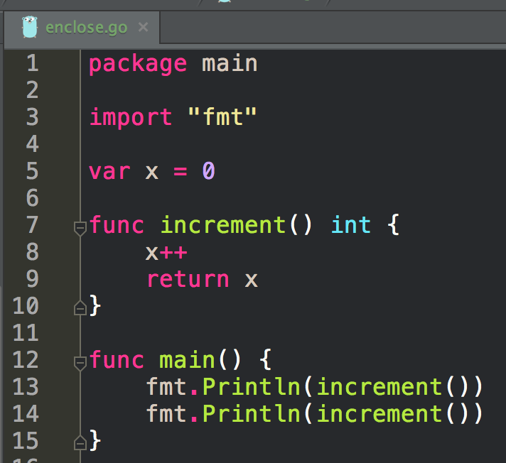
not using closure
closure helps us limit the scope of variables that are used by multiple functions
without closure, for two or more funcs to have access to the same variable, that variable would need to be package scope

Slide 29
not using closure
closure

Slide 30
returning a func

Slide 31
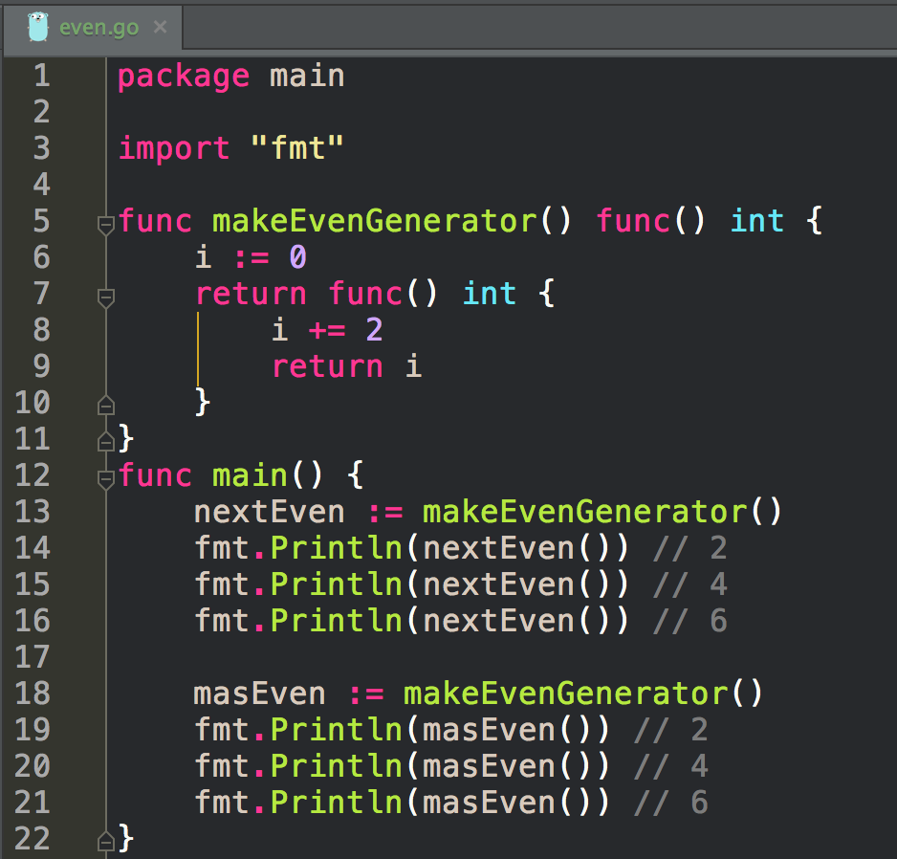
a func is returned
closure
closure helps us limit the scope of variables that are used by multiple functions
without closure, for two or more funcs to have access to the same variable, that variable would need to be package scope
nextEven & masEven are each holding/enclosing the variable i

Slide 32
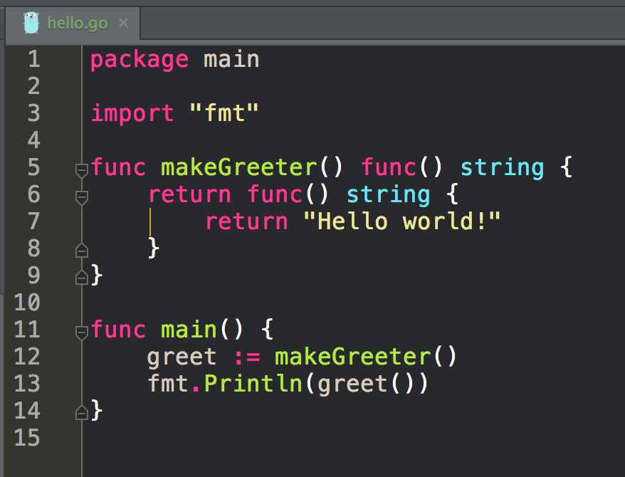
a func is returned
returning a func
(not part of func expression)
another func expression
setting a variable equal to a func

Slide 33
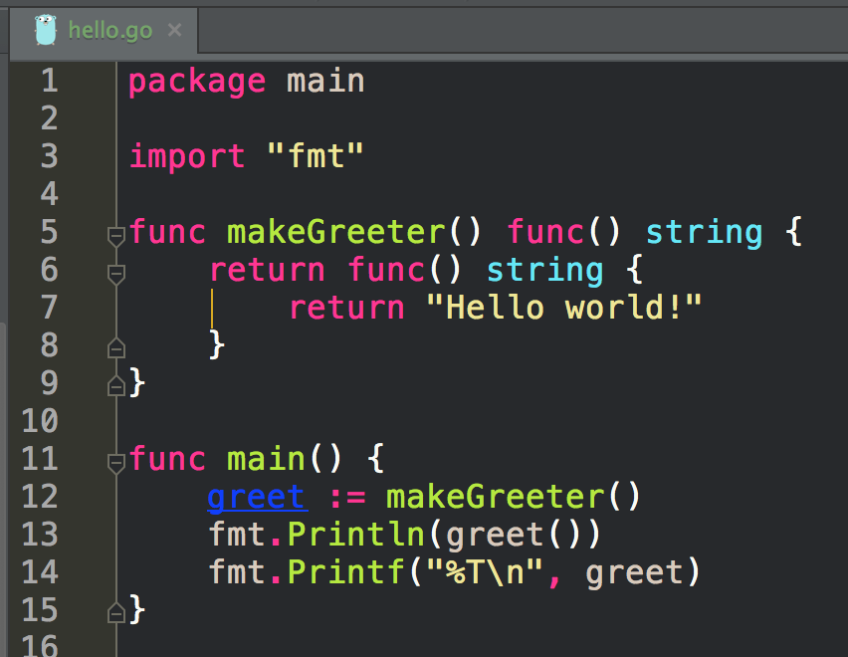
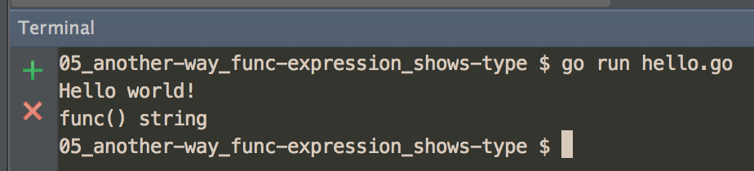
a func is returned
interesting to look at greet’s type

Slide 34
callback
passing a func as an argument

Slide 35
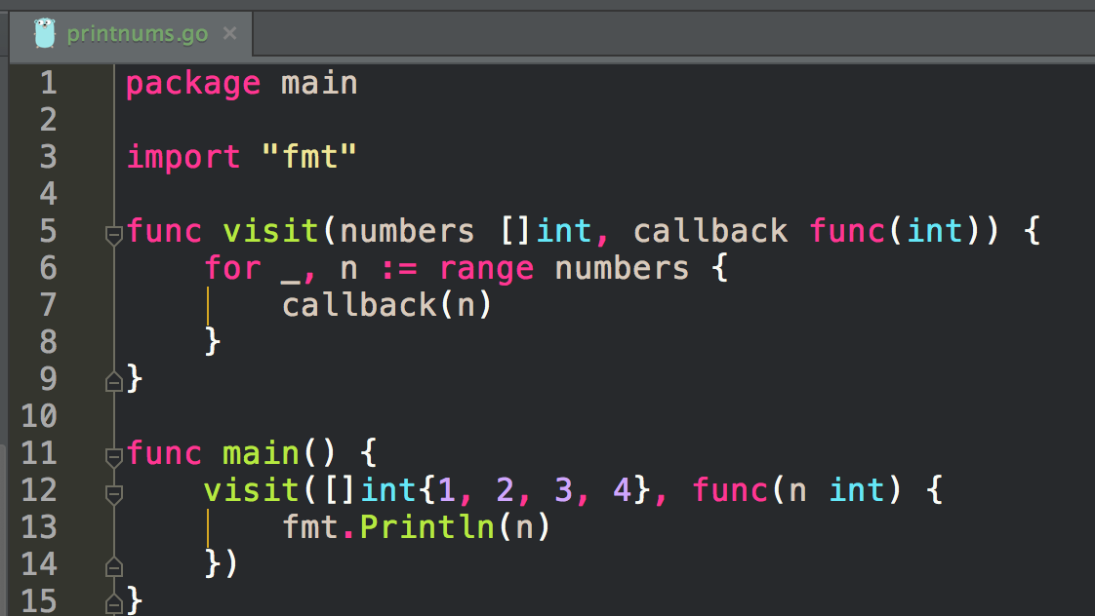

Slide 36
func visit takes two arguments
another func
the callback
a slice of ints

Slide 37
func visit takes two arguments
another func
the callback
a slice of ints
pass in the
slice of ints

Slide 38
func visit takes two arguments
another func
the callback
a slice of ints
pass in the
slice of ints
pass in a func
the callback

Slide 39
the func passed as an argument
(the callback)
is assigned to the parameter “callback”
and then gets used

Slide 40
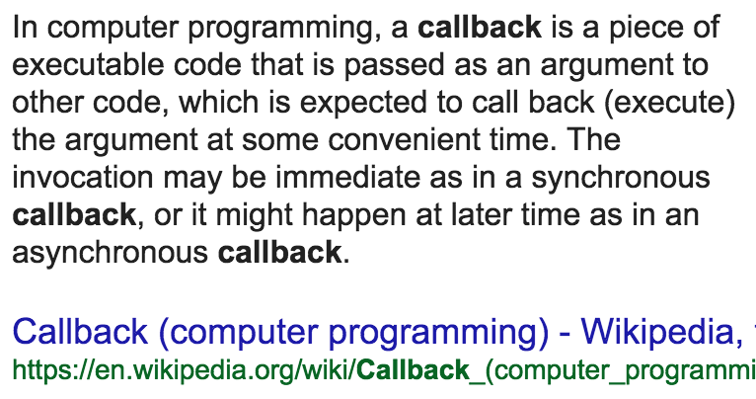
wikipedia’s description

Slide 41
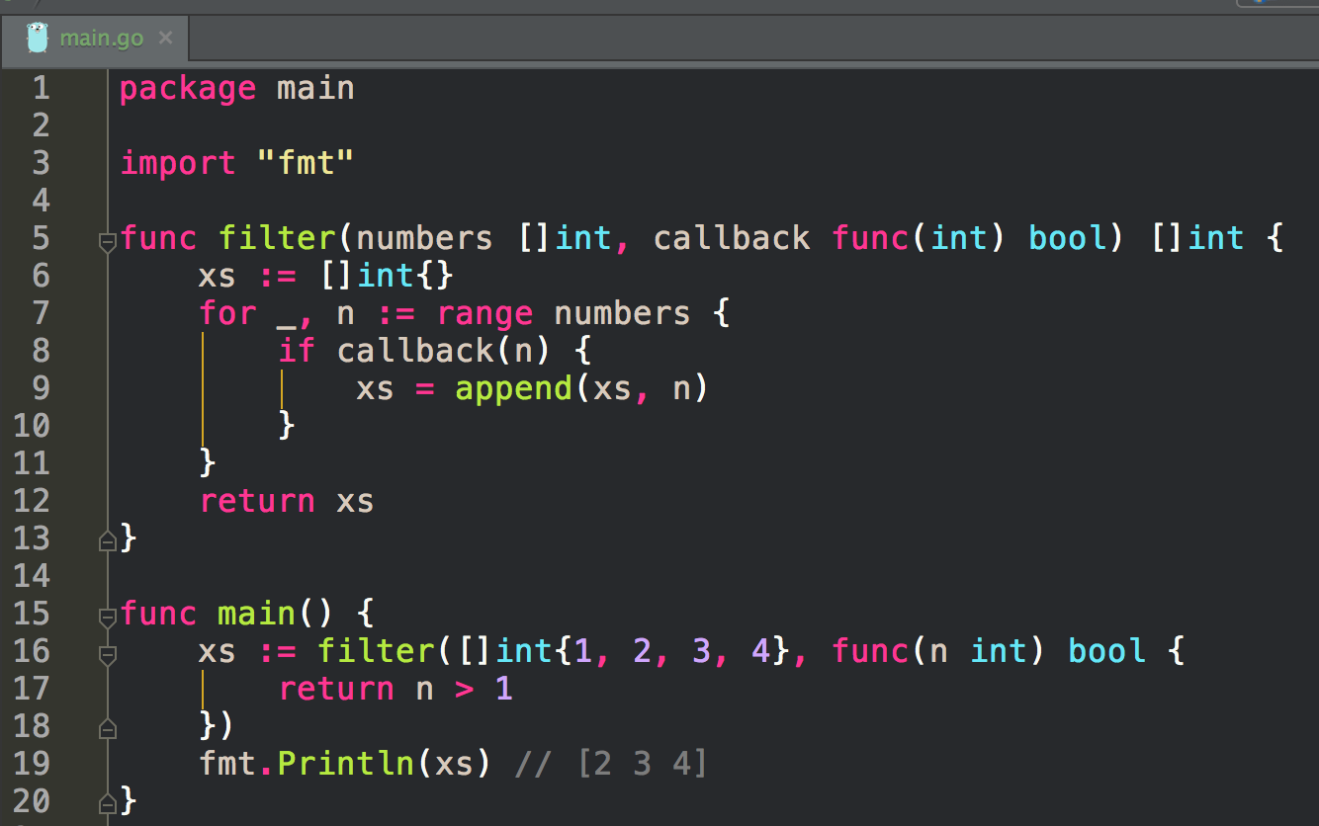
another callback
can you explain this code?

Slide 42
“If you’ve done functional programming like Lisp or Haskell, this way of dealing with functions is super common; it’s an approach to development; you get used to passing functions around. Go allows you to do that [passing functions around] but it’s not the most common way of writing code. The more normal way you’d write code [for something like the code above] would just be a simple for loop. For loops are easy to understand.”
~ Caleb Doxsey

Slide 43
recursion
a func that can call itself

Slide 44
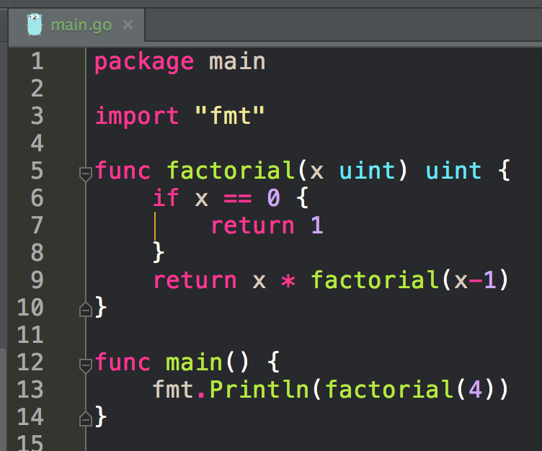
The End Result:
24
Can you pencil out how the answer, 24, was reached?
recursion

Slide 45
factorial(4)
returns: 4 * factorial(3)
factorial(3)
returns: 3 * factorial(2)
factorial(2)
returns: 2 * factorial(1)
factorial(1)
returns: 1 * factorial(0)
factorial(0)
returns: 1
----------------------------------------------------
returns: 4 * 3 * 2 * 1 * 1
----------------------------------------------------
The End Result:
4 * 3 * 2 * 1
recursion

Slide 46
This is called the base case
You can always use loops to solve any problem that can be solved with recursion.
Loops are more performant than recursion.
recursion

Slide 47
defer
run this at the last possible moment

Slide 48
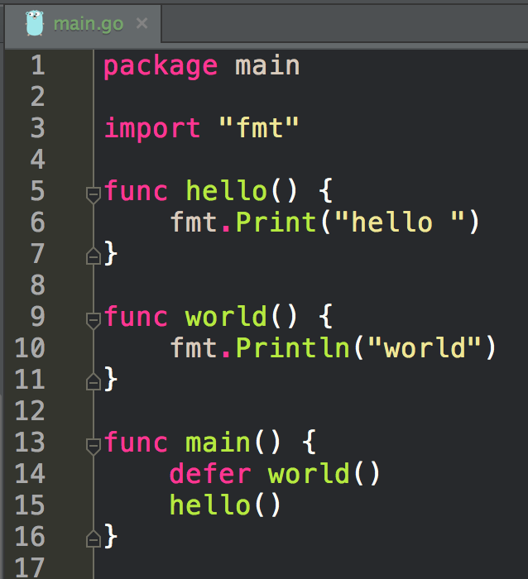
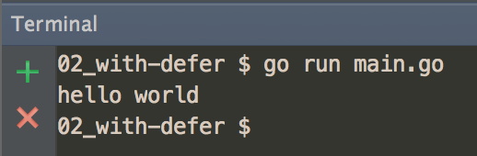

Slide 49
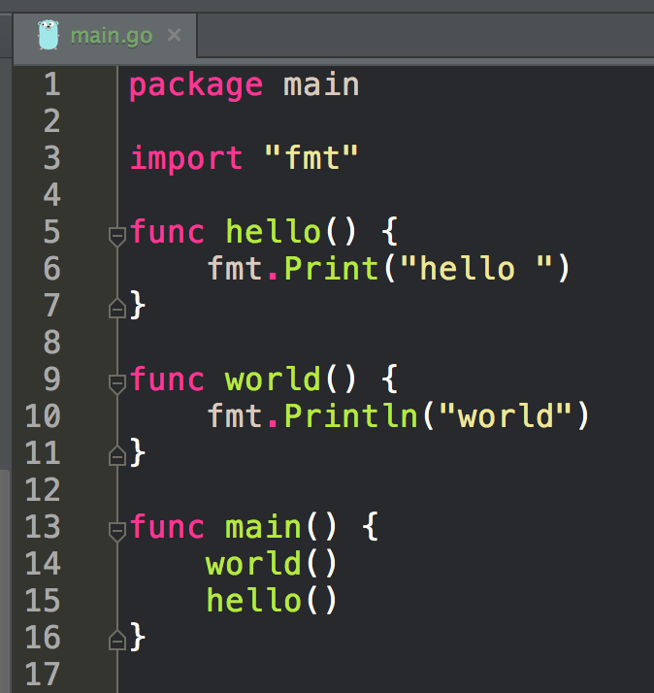
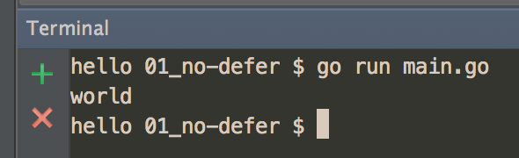

Slide 50
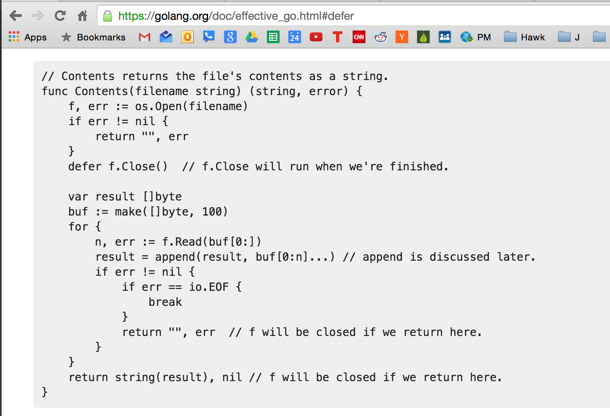

Slide 51
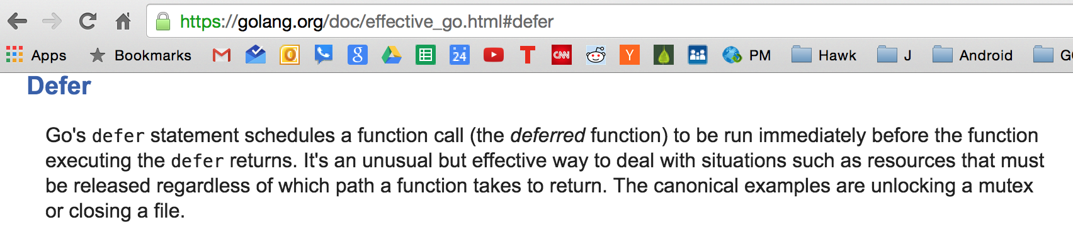

Slide 52
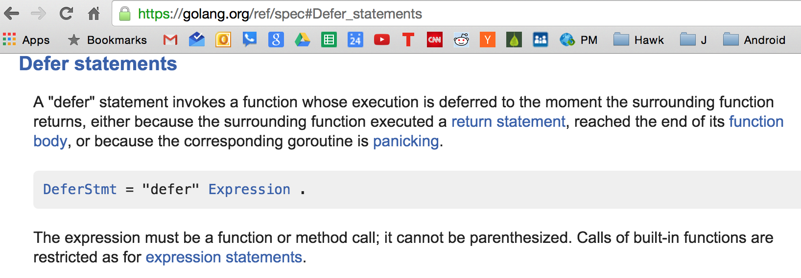

Slide 53
the stack

Slide 54
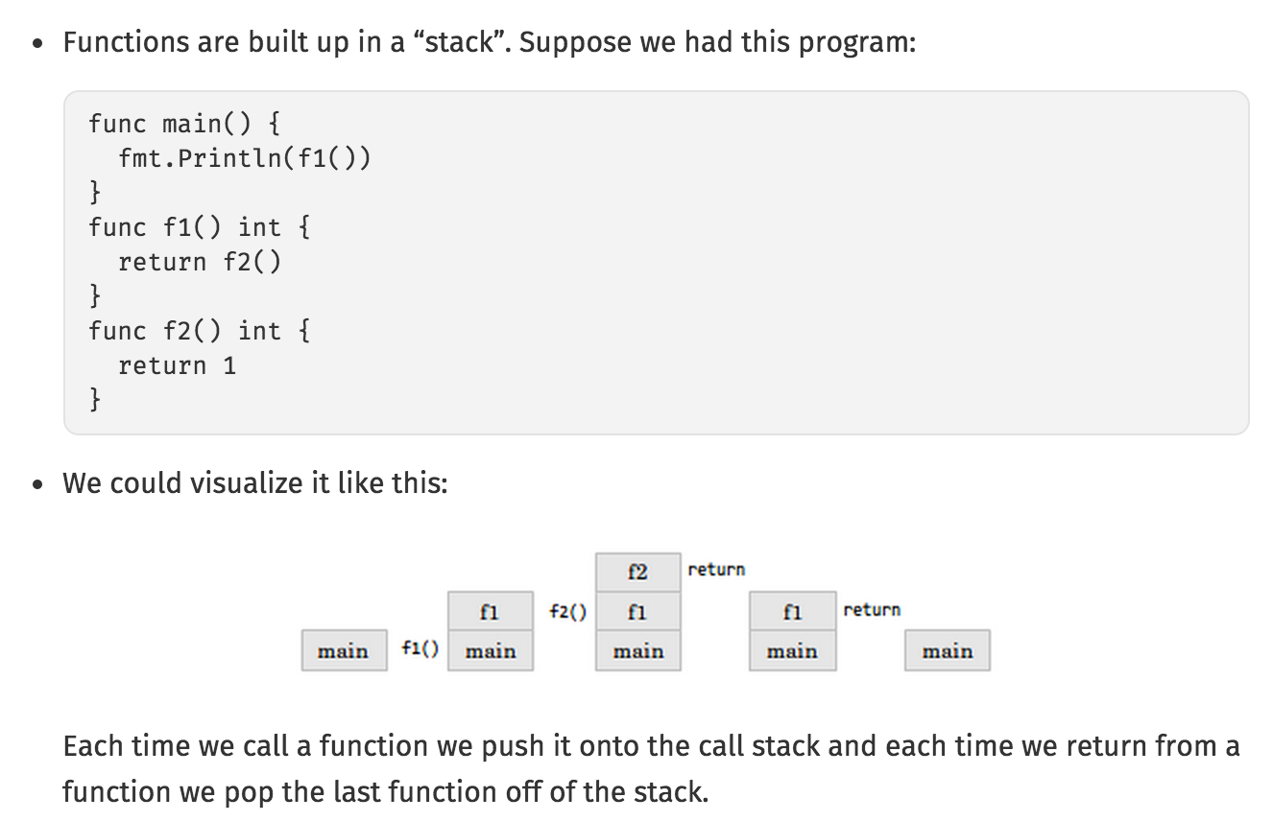
http://www.golang-book.com/books/intro/7

Slide 55
learn more
learn more about functions

Slide 56
Review
func main() {}
calling a function
greeting()
parameters vs arguments
two params
variadic
…params
args...
returns
named returns
multiple returns
variable shadowing
func expression
setting a variable equal to a function
greeting := func(){<code here>}
greeting’s type is func
closure
one thing enclosing another
helps us limit scope of variables
returning a func
functional programming
callback
passing a func as an argument
recursion
defer
the stack
the order in which functions are called

Slide 57
exercises

Slide 58
bool
Write a program that prints the value of this expression:
(true && false) || (false && true) || !(false && false)

Slide 59
two params
Write a program that calls a function which takes first name and age
then returns a string like this, “John is 27 years old.”

Slide 60
two returns
Write a program that calls a function which takes first name and age
then returns an int and a bool
the int: person’s age * 7 (dog years)
the bool: whether or not the person is old (age > 25)
use those two returns in a sentence like this,
(“John is 140 in dog years and is not old”)
or like this, (“Jane is 280 in dog years and is old”)

Slide 61
named return
Write a program that calls a function which takes age
then returns dogYears int which is age * 7

Slide 62
variadic parameters
Write a program that has variadic parameters
use that function in a program

Slide 63
variadic arguments
Write a program that has variadic parameters
use that function in a program, passing in variadic arguments

Slide 64
func expression
Write a program that uses a func expression

Slide 65
variable type
You wrote a program that uses a func expression
now add a print statement that shows
the type of the variable to which the function is assigned

Slide 66
closure
create a program that uses closure

Slide 67
returning a func
create a func that returns a func
use that func in a program

Slide 68
callback
create a program that uses a callback
(a func is being passed in as an argument)

Slide 69
recursion
The Fibonacci sequence is defined as: fib(0) = 0, fib(1) = 1, fib(n) = fib(n-1) + fib(n-2). Write a recursive function which can find fib(n).

Slide 70
defer
create a program that uses defer

Slide 71
review questions

Slide 72
Answer These Questions
What is variable shadowing?
What is a func expression?
What is closure?
What is a callback?
How does defer work?
What is the stack and how does it work?

